Slide 1


Backprop, 25 Years Later: Biologically Plausible Backprop
Randall C. O’Reilly
University of Colorado Boulder
eCortex, Inc.

Slide 2
Outline
Backpropagation via activation differences: Generalized Recirculation (GeneRec)
Bottom-up derivation of activation differences from STDP
Bidirectional activation dynamics vs. feedforward networks

Slide 3
Recirculation (early RBM)

Slide 4
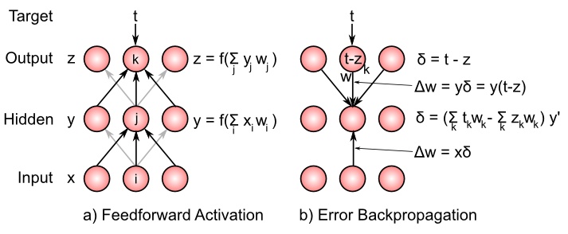
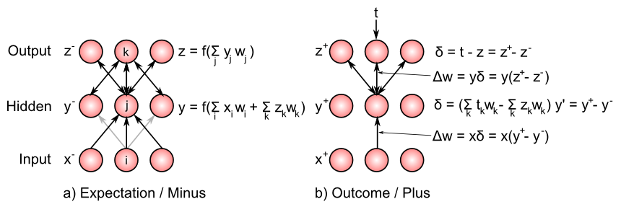
Generalized Recirculation (GeneRec) (O’Reilly, 1996 – see also Xie & Seung, 2003)

Slide 5
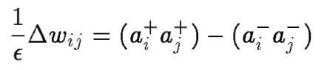
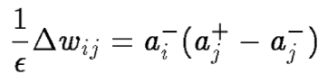
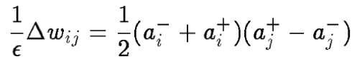
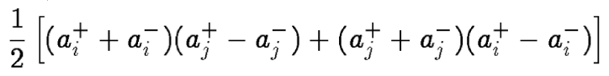
Contrastive Hebbian Learning (CHL) (Movellan, 1990; Hinton 1989 DBM)
CHL, DBM:
GeneRec:
Avg Sender:
^ Symmetry = CHL

Slide 6
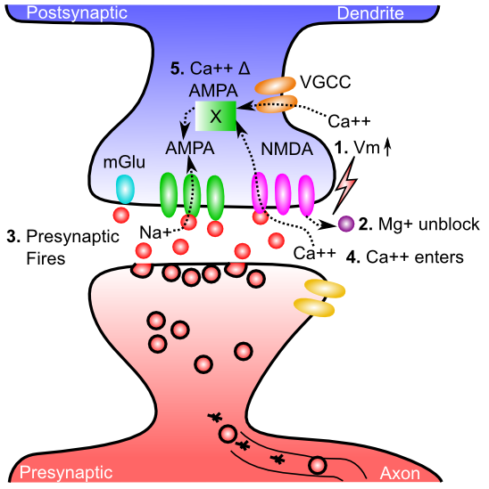
Biology of Learning

Slide 7
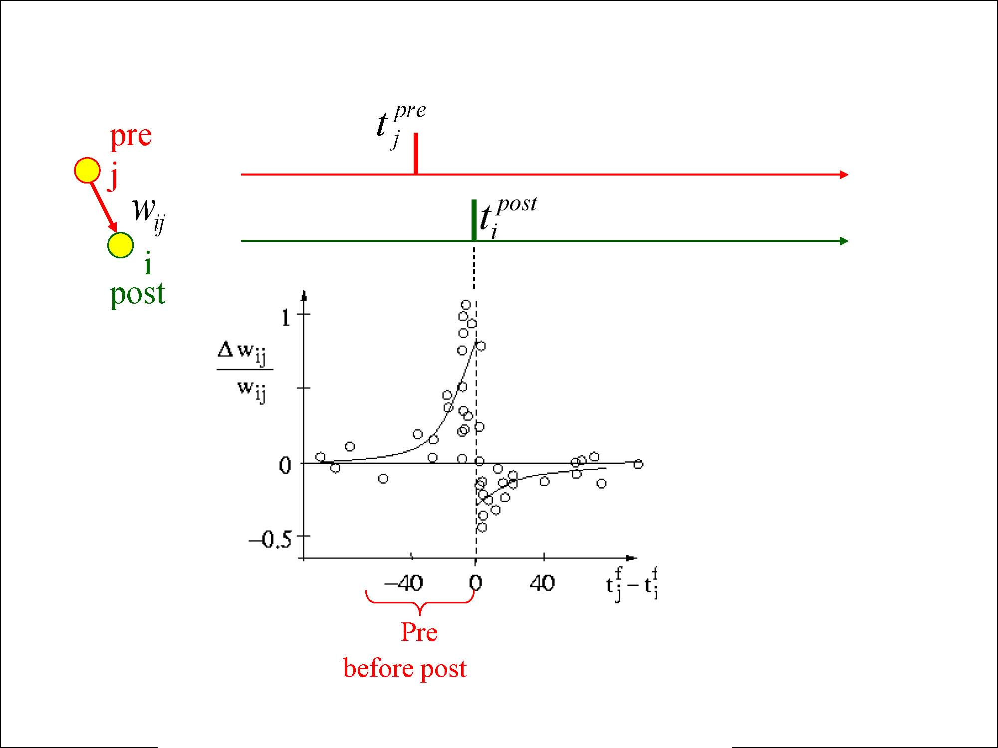
STDP: Spike Timing Dependent Plasticity

Slide 8
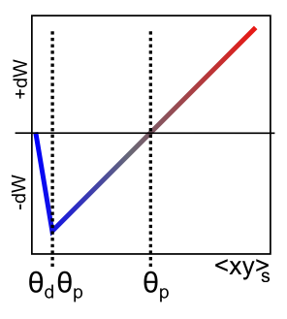
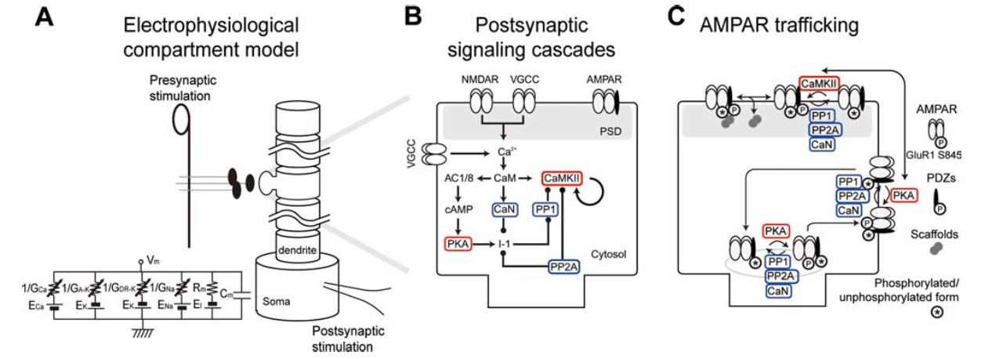
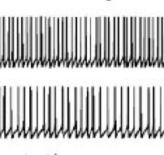
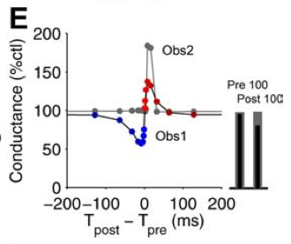
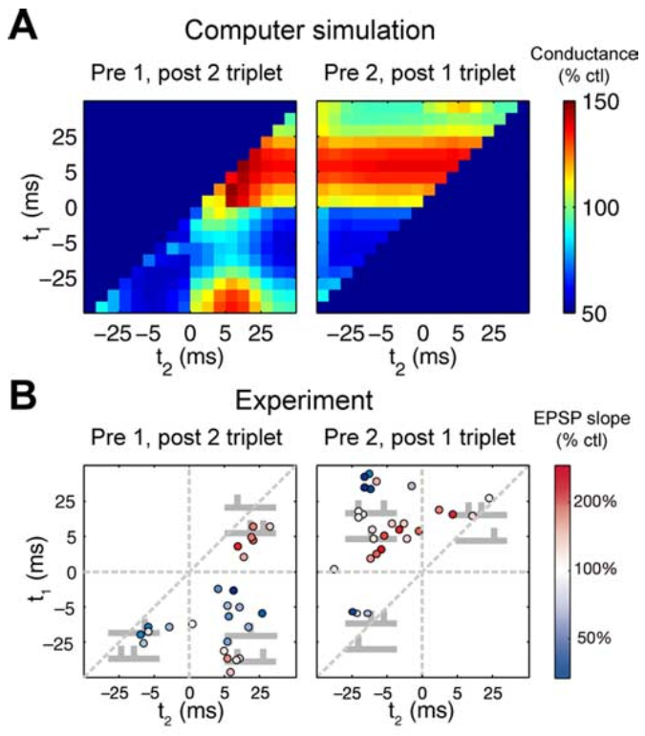
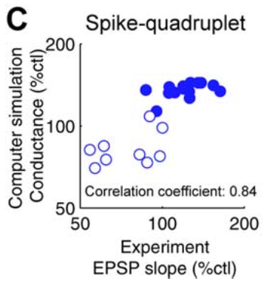
Error-driven Learning from STDP (computational ⬅➔ biological bridge)
Urakubo et al, 2008
Real spike
trains in..
Captures ~80% of variance in model LTP/LTD
(Linearized BCM)
Fits to STDP data for pairs, triplets, quads

Slide 9
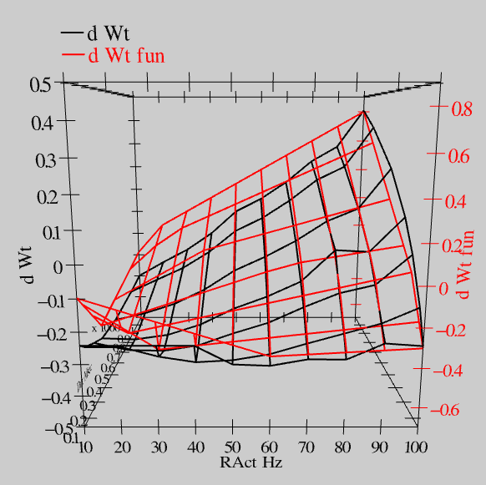
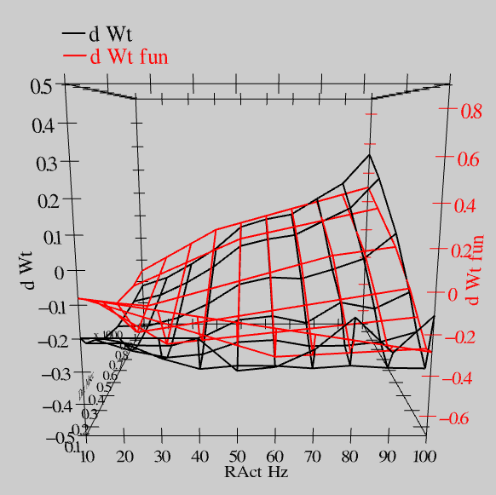
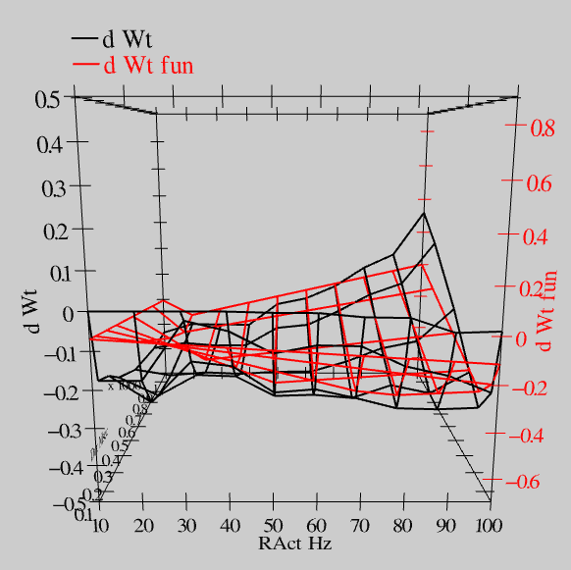
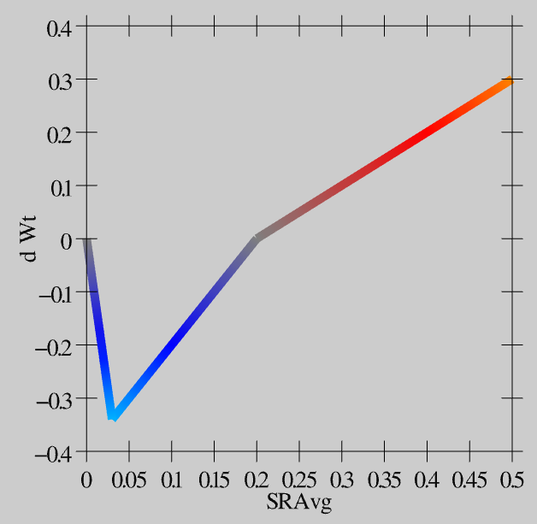
Extended Spike Trains = Emergent Simplicity
S = 100Hz
S = 50Hz
S = 20Hz
dW = f(send * recv) =
(spike rate * duration)
r=.894

Slide 10
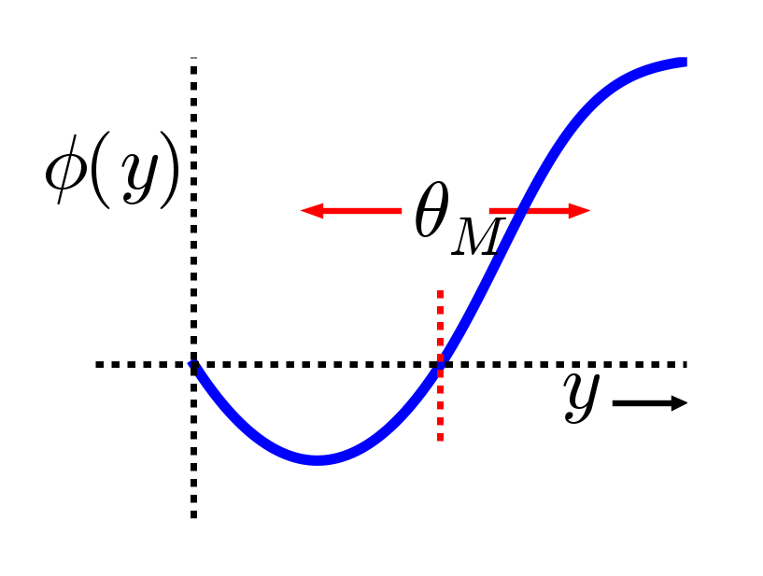
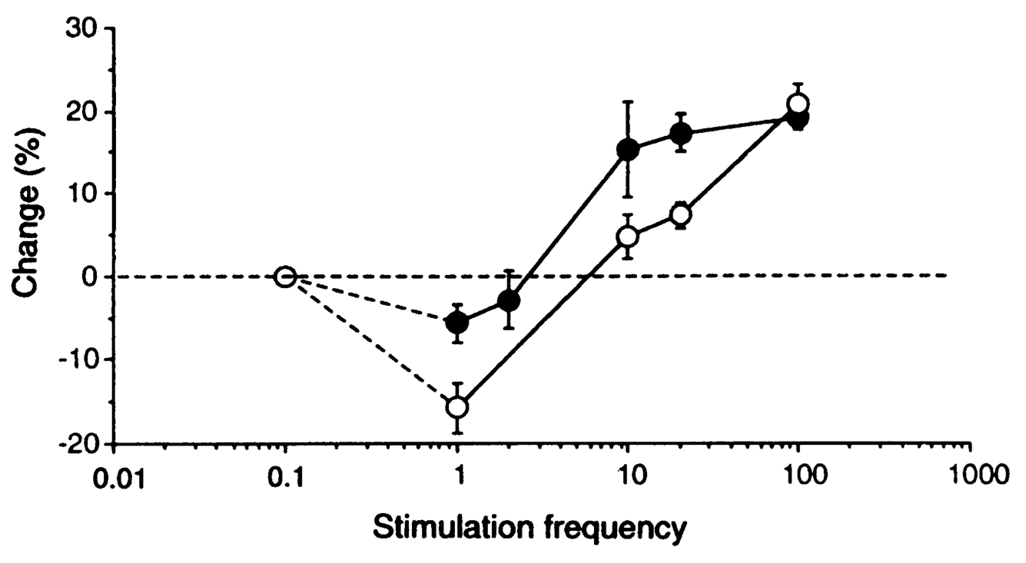
Bienenstock Cooper & Munro (1982)
Floating threshold =
Homeostatic regulation
More robust form of Hebbian learning
Kirkwood et al (1996):

Slide 11
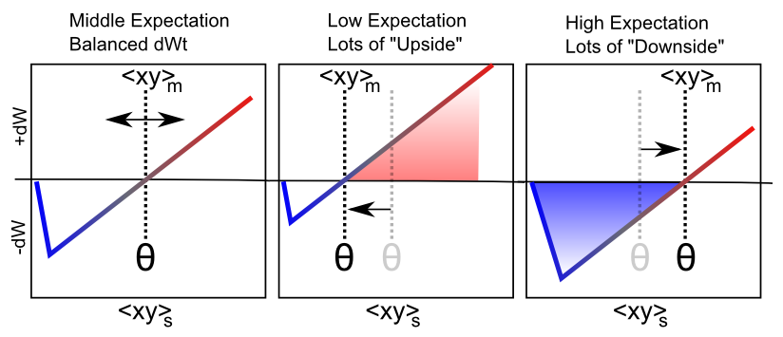
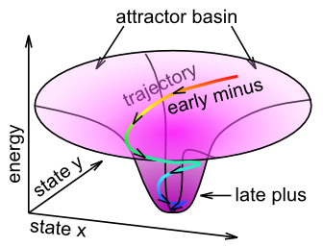
Fast Threshold Adaptation: Outcome vs. Expectation
dW ≈ <xy>_{s} - <xy>_{m}
outcome – expectation
XCAL = temporally eXtended Contrastive Attractor Learning
Notes:
With a linear function, threshold is exactly what is subtracted

Slide 12
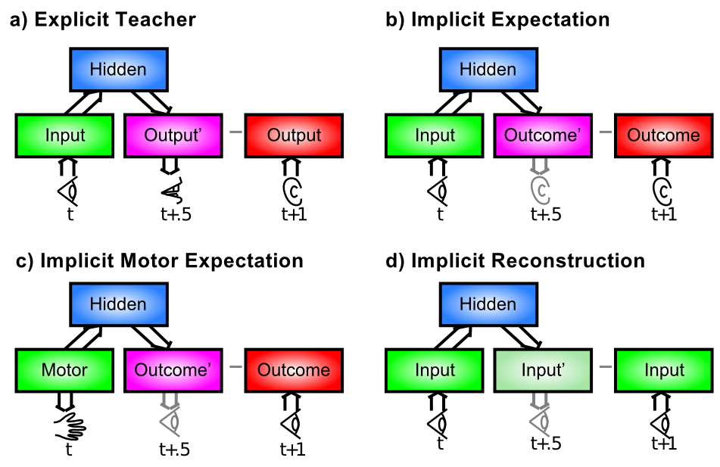
Where Does Error Come From?

Slide 13
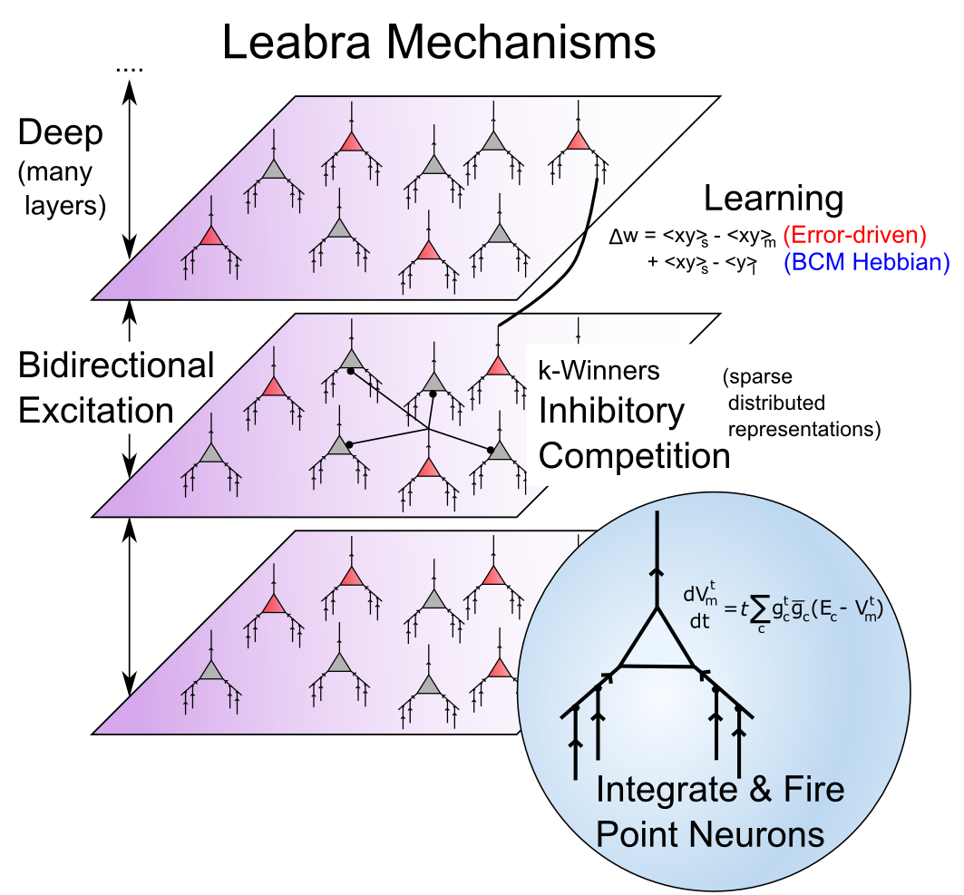
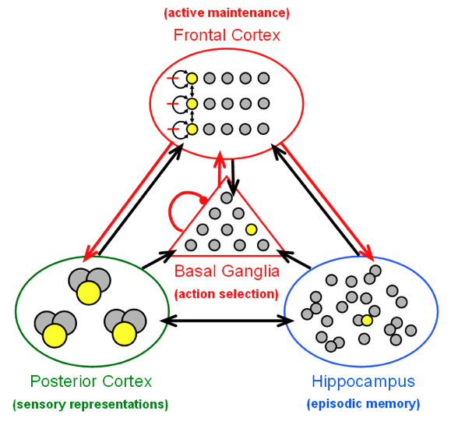
Biological Modeling Framework http://ccnbook.colorado.edu
Same framework accounts for wide range of cognitive neuroscience phenomena: perception, attention, motor control and action selection, learning & memory, language, executive function…

Slide 14
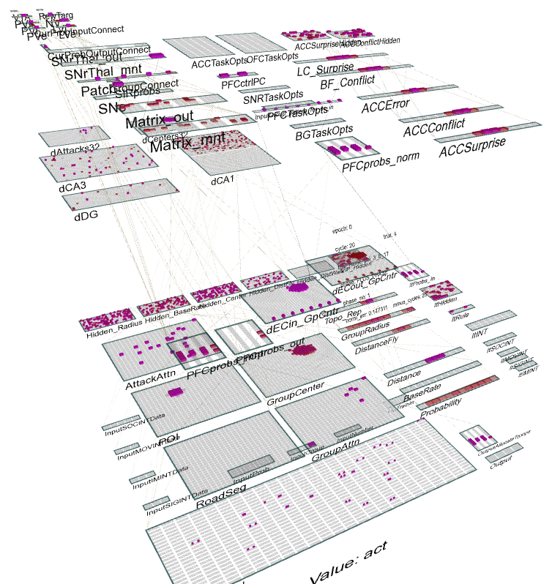
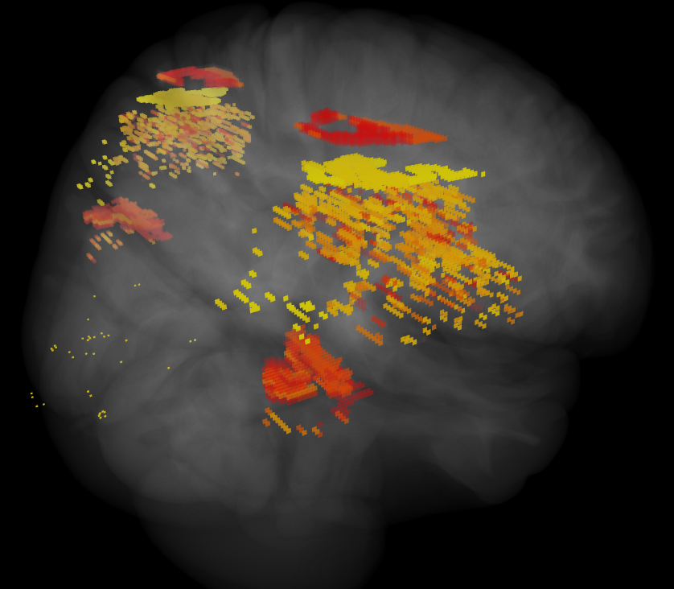
ICArUS-MINDS (IARPA) Integrated Cognitive Architecture for Understanding Sensemaking Mirroring Intelligence in a Neural Description of Sensemaking
Team: HRL (R. Bhattacharyya), CU Boulder (R. O’Reilly), CMU (C. Lebiere), UTH (H. Wang), PARC (P. Pirolli), UCI (J. Krichmar)
Goal: Build biologically-based cognitive architecture to model intelligence analyst.
Brain areas:
Posterior Cortex (IT, Parietal)
PFC/BG/DA
Hippocampus
BNS: LC, ACh

Slide 15
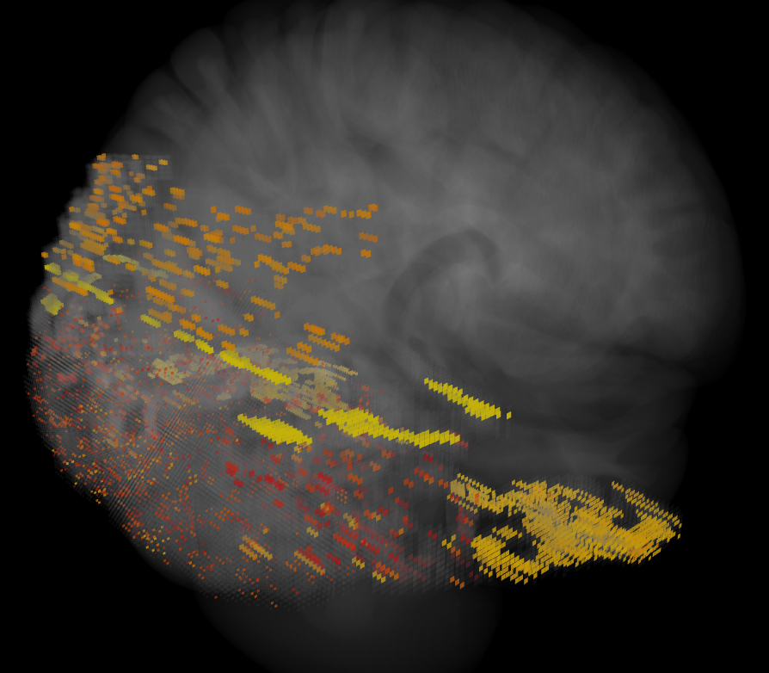
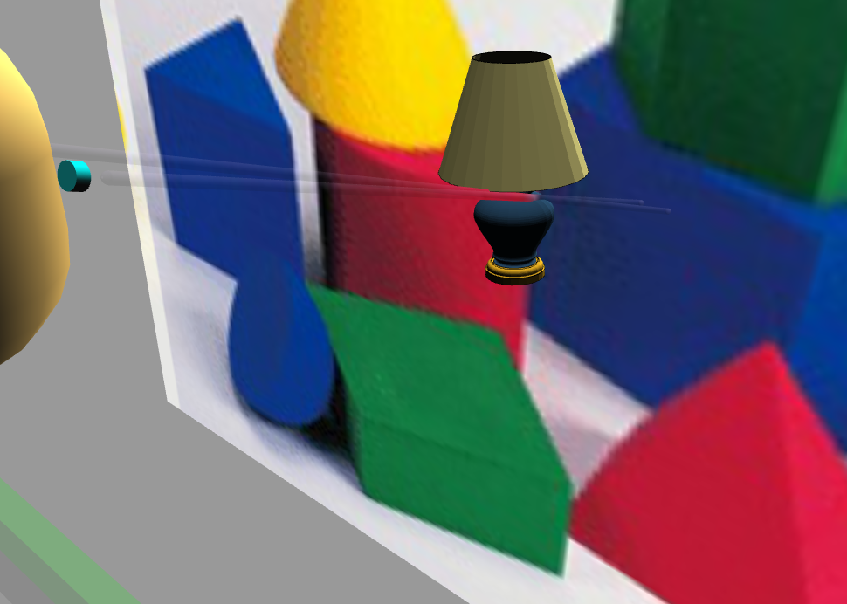
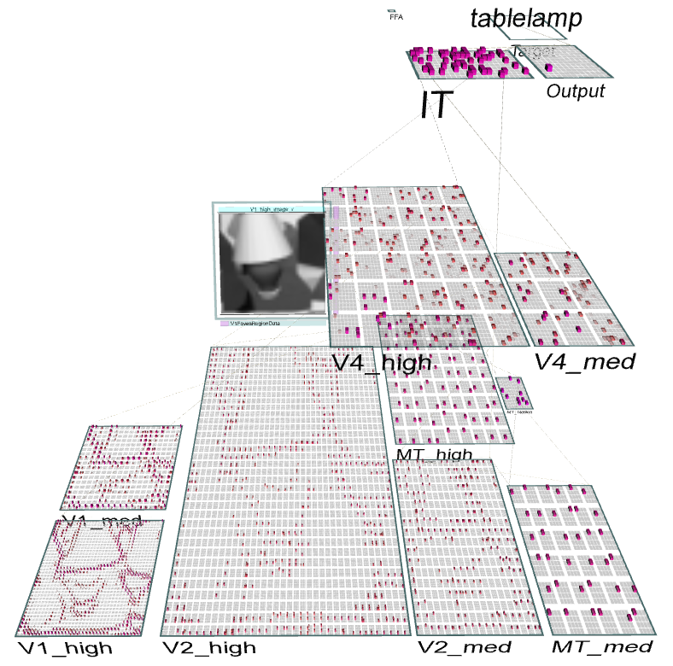
Emer Virtual Robot: Perceptual Motor Control & Robust Object Recognition

Slide 16
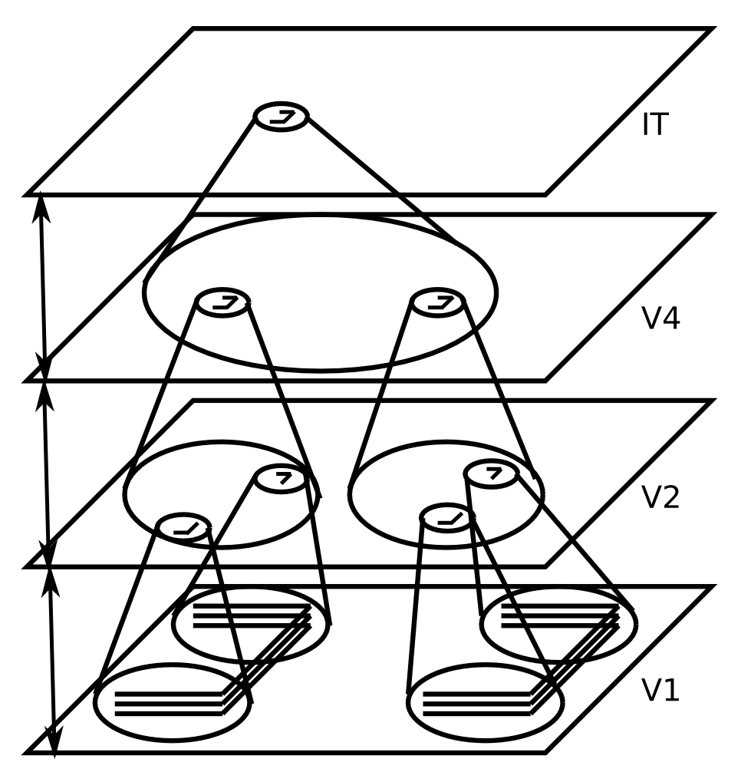
Invariant Object Recognition
Hierarchy of increasing:
Feature complexity
Spatial invariance
Strong match to RF’s in corresponding brain areas
(Fukushima, 1980; Poggio, Riesenhuber, et al…)

Slide 17
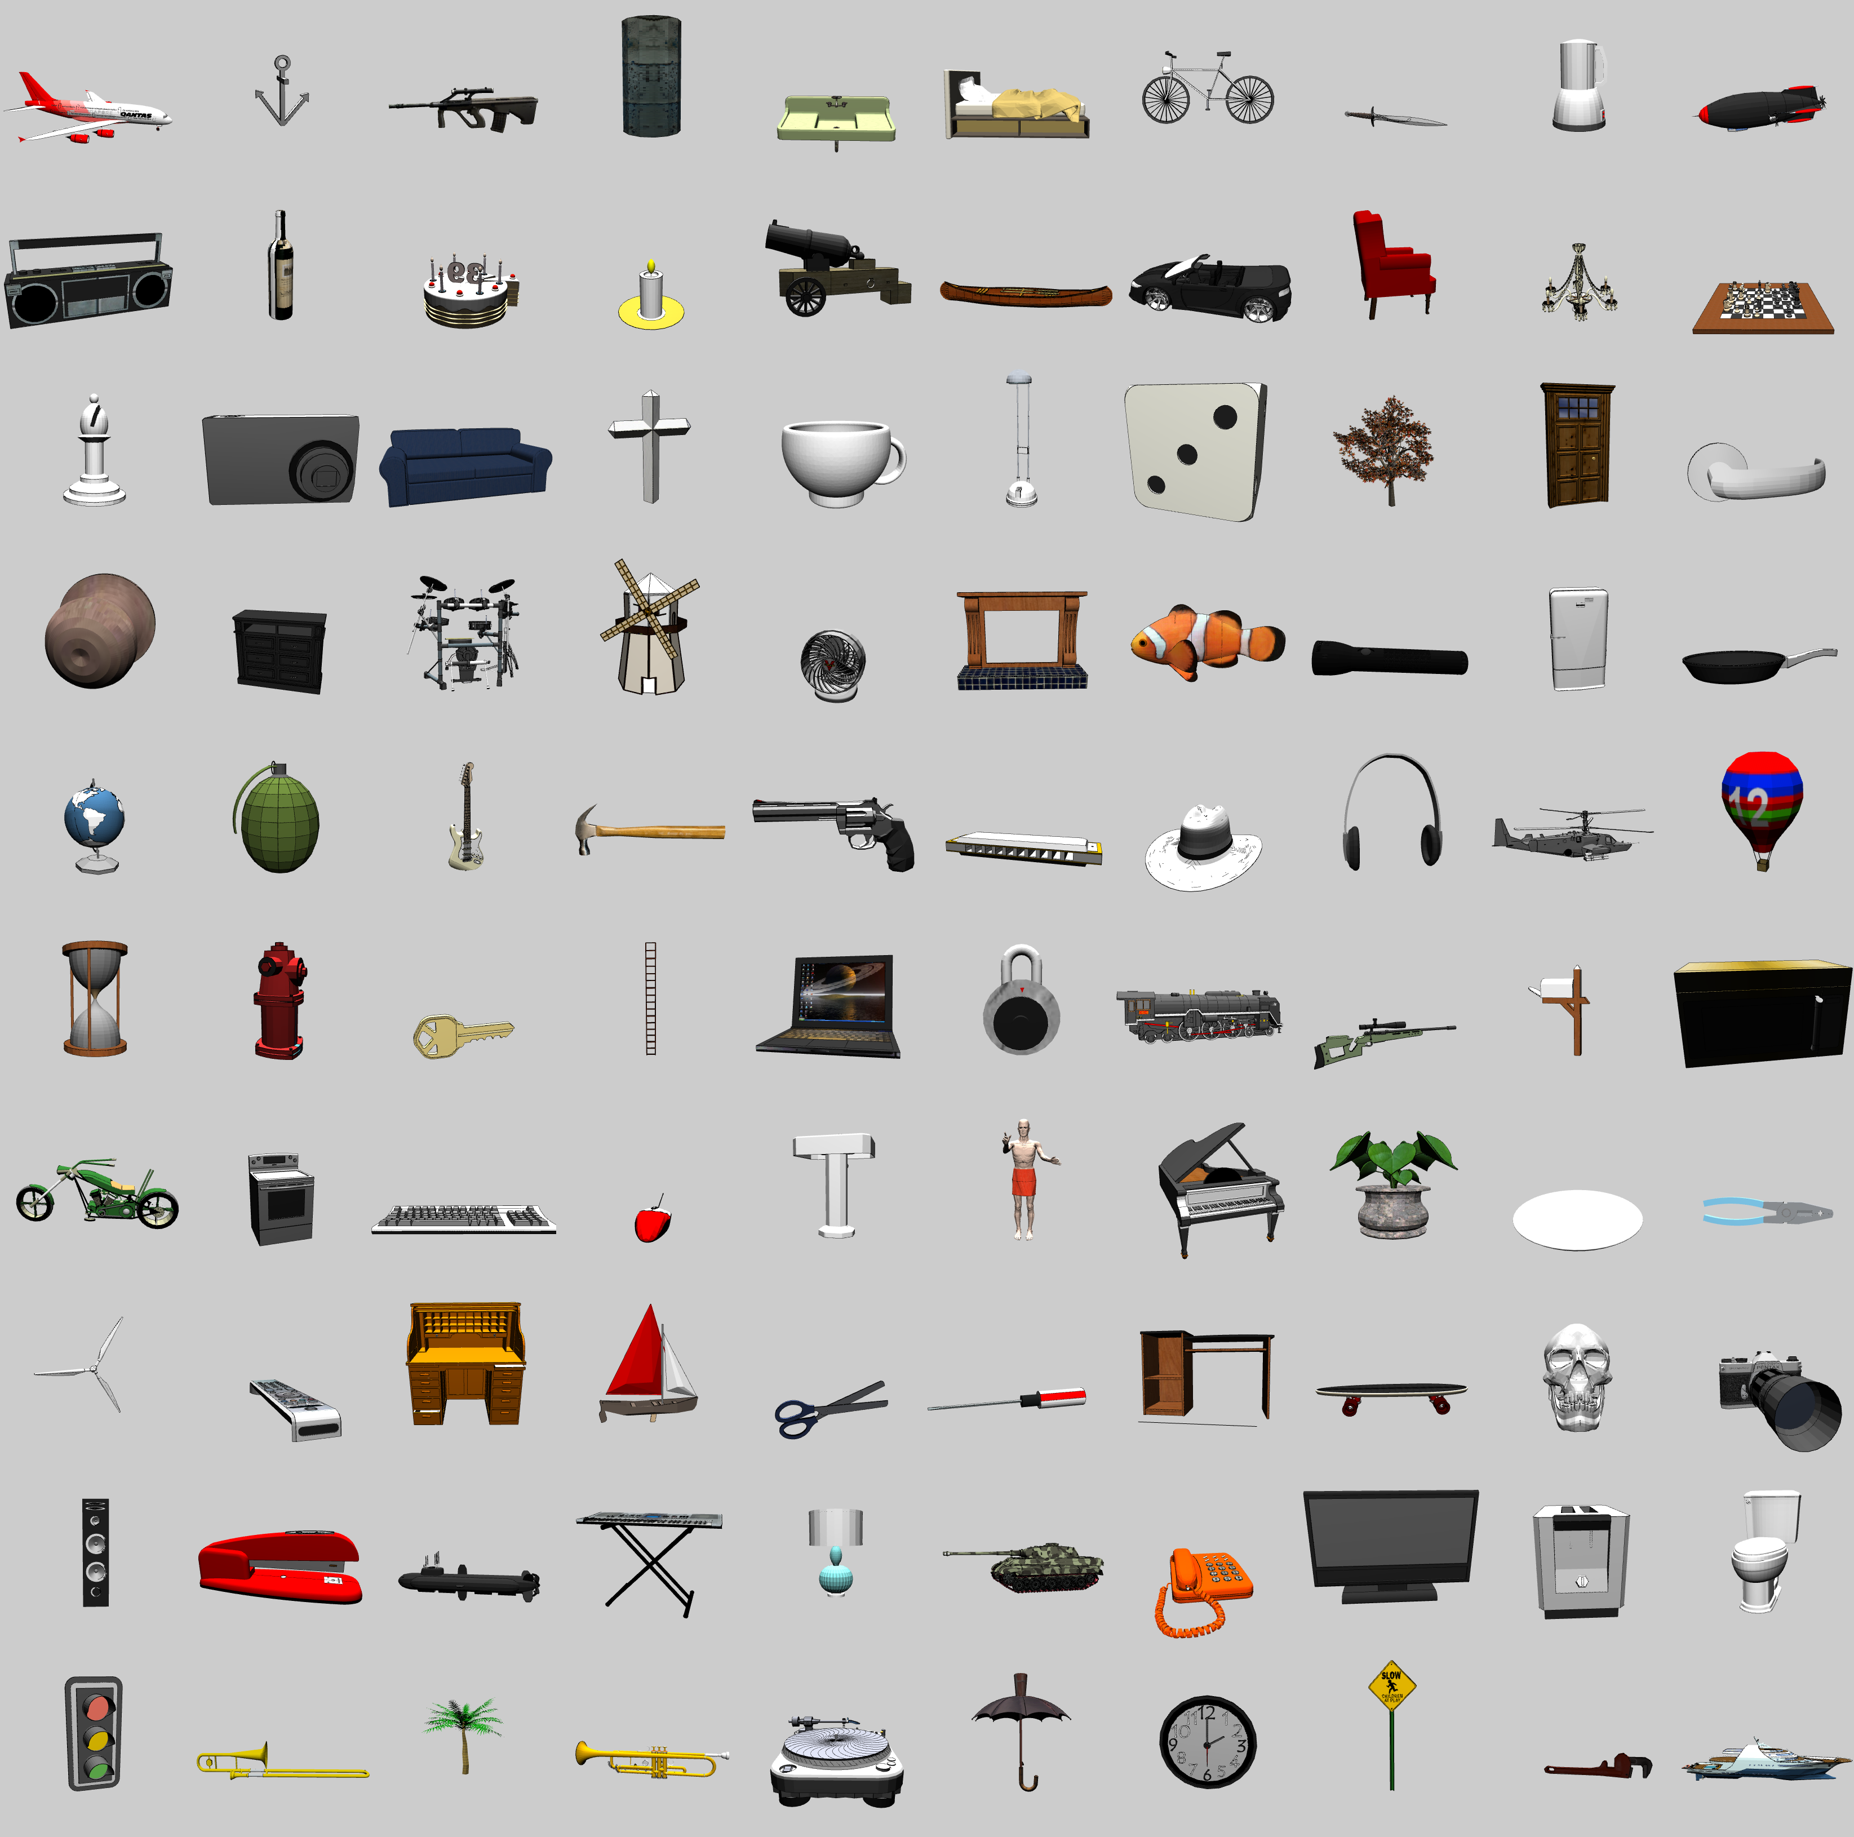
3D Object Recognition Test
From Google SketchUp Warehouse
100 categories
8+ objects per categ
2 objects left out for testing
+/- 20° horiz depth rotation + 180° flip
0-30° vertical depth rotation
14° 2D planar rotations
25% scaling
30% planar translations

Slide 18
Object Recognition Generalization Results

Slide 19
Thanks To
CCN Lab
Tom Hazy
Seth Herd
Tren Huang
Dave Jilk (eCortex)
Nick Ketz
Trent Kriete
Kai Krueger
Brian Mingus
Jessica Mollick
Wolfgang Pauli
Sergio Verduzco-Flores
Dean Wyatte
Funding
ONR – McKenna & Bello
iARPA – Minnery
NSF SLC - TDLC
DARPA - BICA
AFOSR
NIMH P50-MH079485

Slide 20
Extras

